Slide 1

INVISIBLE WATERMARKING USING
LSB SUBSTITUITION METHOD
By:
Lakshmi tirupatamma.K
O170510
ECE-5
Batch no:43

Slide 2
Contents
Introduction
Types of watermarking
Image watermarking
Algorithm (LSB)
Related works
Advantages & Disadvantages
Applications
Future Scope

Slide 3
Introduction
Image processing and the internet have made it easier to
duplicate,modify,reproduce and distribute digital images so quickly that it threatens the privacy and security of data.Therefore,content authentication,copyright protection,and protection against duplication plays a keyrole in facing challenges of existing and upcoming threats in maintaing digital information.

Slide 4
Watermarking
Watermarking is the process of hiding digital information in a carrier signal; the hidden information should, but does not need to, contain a relation to the carrier signal. Digital watermarks may be used to verify the authenticity or integrity of the carrier signal or to show the identity of its owners.

Slide 5
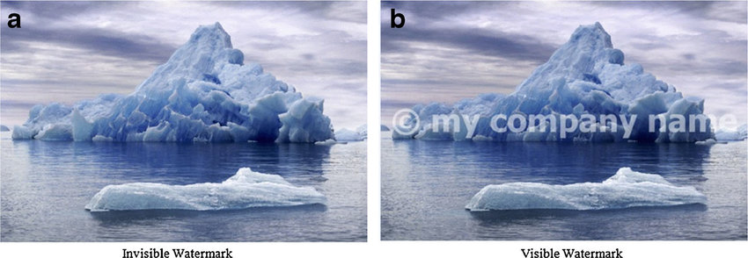
Types of watermarks
Visible Watermarks –These watermarks are visible.
Invisible Watermarks –These watermarks are embedded in the media and use steganography technique. They are not visible by naked eyes.

Slide 6
Types of watermarks contd....
Public Watermarks –
These can be understood and modified by anyone using certain algorithms. These are not secure.
Fragile Watermarks –
These watermarks are destroyed by data manipulation. There must be a system which can detect all changes in the data if fragile watermarks are to be used.

Slide 7
Digital watermarking process (Life cycle) :
The information needs be embedded in the media. The signal which is embedded is the host signal and the information is called digital watermark. The process has 3 main parts:
Embed –
In this part, the digital signal is embedded with the digital watermark.
Attack –
The moment when the transmitted media is changed, it becomes a threat and is called an attack to the watermarking system.
Protection –
The detection of the watermark from the noisy signal which might have altered media (JPEG compression, rotation, cropping, and adding noise) is called Protection.

Slide 8
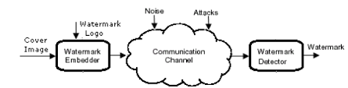
Basic watermarking algoritm

Slide 9
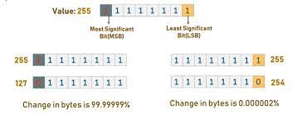
LSB(least significant bit) algorithm

Slide 10
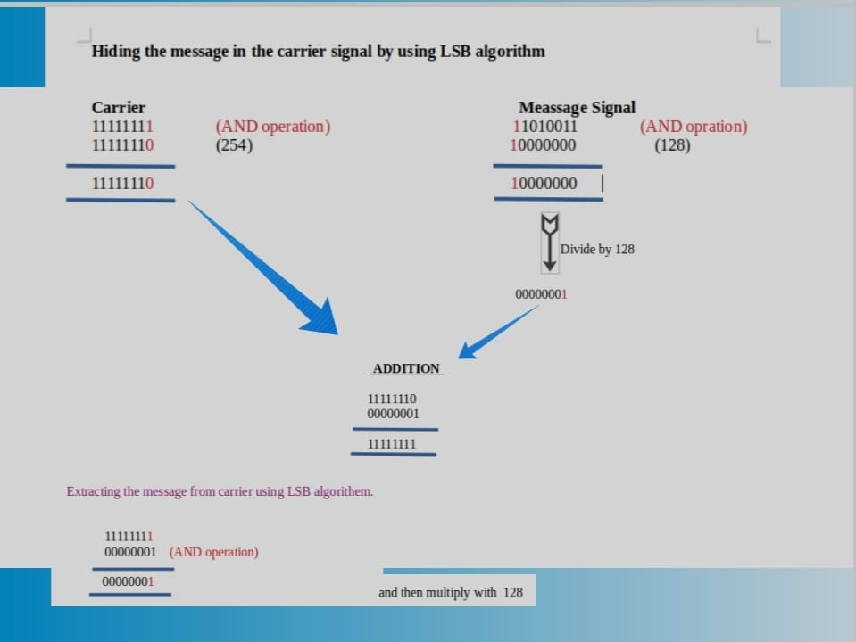

Slide 11
Related works
Adaptive LSB watermarking using PVD
Wu & Tsai proposed the pixel value differencing (PVD) technique to hide the secret data in an image. The fundamental idea was to find the pixel value difference between every pair of consecutive pixels, if the difference is larger, then a greater number of bits can be embedded in this pair of pixels. If this difference is smaller, then fewer number of bits can be hidden in this pair of pixels. This technique can be detected by pixel difference histogram (PDH) analysis .

Slide 12
LSB substituition using Gene expression
A model developed using the key-Permutation method with
the proposed gene expression programming algorithm to
select the key that is optimal from all possible keys in such a
way that minimum effect could be noticed in the stego-image
after embedding the data by the selected key. The GEP
algorithm distinguishes with its high accuracy and its fast
performance, due to its structure.

Slide 13
OPAP
Another extension of the LSB algorithm is OPAP (Optimal Pixel Adjustment Procedure). The OPAP scheme computes the difference between pixels in the cover image and the stego image and then changes the hidden bits to improve the transparency of the steganography process . Thus, OPAP provides a high value of PSNR (Peak Signal-to-Noise Ratio).

Slide 14
Advantages
It is used in detecting copyright infringements of digital content.
Watermarking is a very secure technique. The embedding of watermarks is done by a key. Anyone who wants to remove the watermark can only do this with the knowledge of the keys involved in embedding.
The embedded version of a file is also digital in nature which can be transmitted and used easily. No change in file format ensures that there is no error or difficulty in using watermarked media.

Slide 15
Disadvantages
Watermarks that are visible are easily removed or overlayed by other watermarks.
There still needs to be invention of more robust techniques to watermark pictures. The pictures with watermarks are easily resized and the watermarks can be cropped.
The owners can remove watermarks easily. This means that if anyone on the owner side can easily manipulate the image and alter the watermark.

Slide 16
Applications
Watermarks are used in forensics. Tampered evidence is unacceptable in forensics and Watermarked images are acceptable.
This is used by brands. The Digital Watermarking is done so that the authority of the digital media is intact.
Digital Watermarking prevents copying of the data.
Video editing software use watermarks so that people buy the full version of it.
It is used in video authentication. News channels often show videos of other agencies which are watermarked. It is also used for ID card security.
It is used for content management in social media.

Slide 17
FUTURE SCOPE
Need for improvement in robustness of watermarking.
For a effective digital watermarking parameters are impercebility,robustness,embedding capacity,execution time,etc...

Slide 18
Conclusion
Evolving with technology.
Need for more robust techniques.

Slide 19
Thank you

